Slide 1
AI for the Industry4.0
Verification of produces fiber optic sensors
Izabela Kania

Slide 2
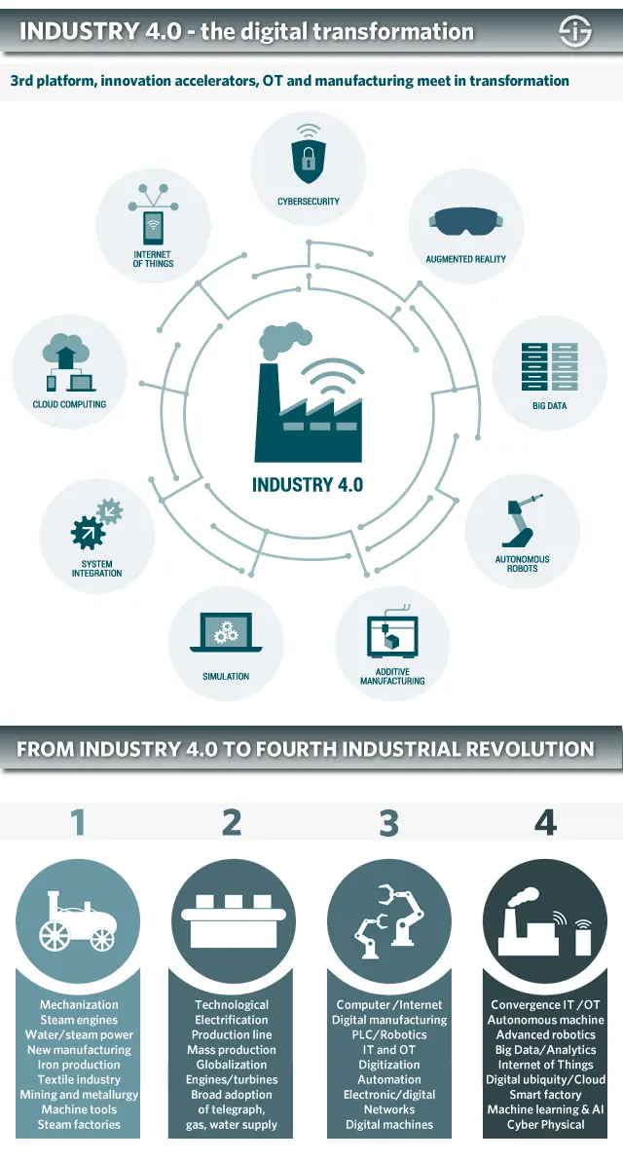
Industry 4.0
is the digital transformation of manufacturing/ production and related industries and value creation processes.
Industry 4.0 has been defined as “a name for the current trend of automation and data exchange in manufacturing technologies, including cyber-physical systems, the Internet of things, cloud computing and cognitive computing and creating the smart factory”.

Slide 3
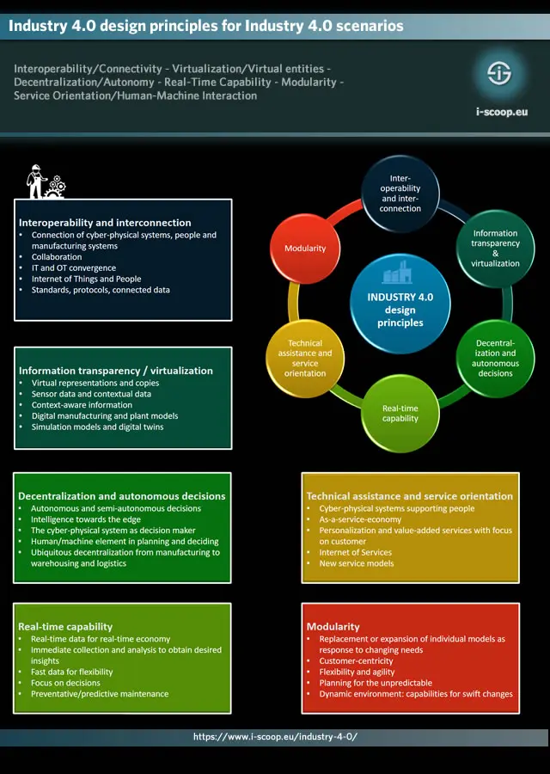
The goal is to enable autonomous decision-making processes, monitor assets and processes in real-time, and enable equally real-time connected value creation networks through early involvement of stakeholders, and vertical and horizontal integration.
Industry 4.0 is is characterized by:
even more automation than in the third industrial revolution,
the bridging of the physical and digital world through cyber-physical systems, enabled by Industrial IoT,
a shift from a central industrial control system to one where smart products define the production steps,
closed-loop data models and control systems and
personalization/customization of products.
The Industry 4.0 design principles:
The design principles of Industry 4.0 enable identifying and realizing applications in industrial transformation. The design principles are:
Interoperability.
Virtualization.
Decentralization.
Real-time capability.
Service orientation.
Modularity.

Slide 4
Project: AI for the Industry 4.0
In a company produces fiber optic sensors they are going to implement the AI techniques to automate verification of produced sensors.
Newly produced sensors characteristics should be verified each time by measuring of spectroscopic signals in three reference substances:
● Air
● Water
● Isopropanol
PROBLEM: procedures are extremely time consuming and require large human resources.
IDEA: AI algorithms implementation in order to predict characteristics (or any other parameters) of a working sensor in water and isopropanol based on measured characteristics in air. It will enable to reduce validation process only to measurements in the air, but other characteristics will be collected based on the proposed model.

Slide 5
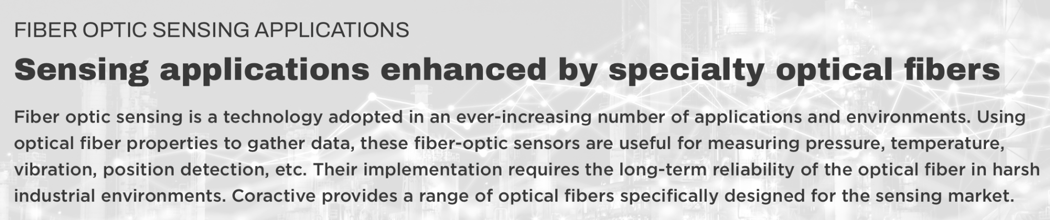
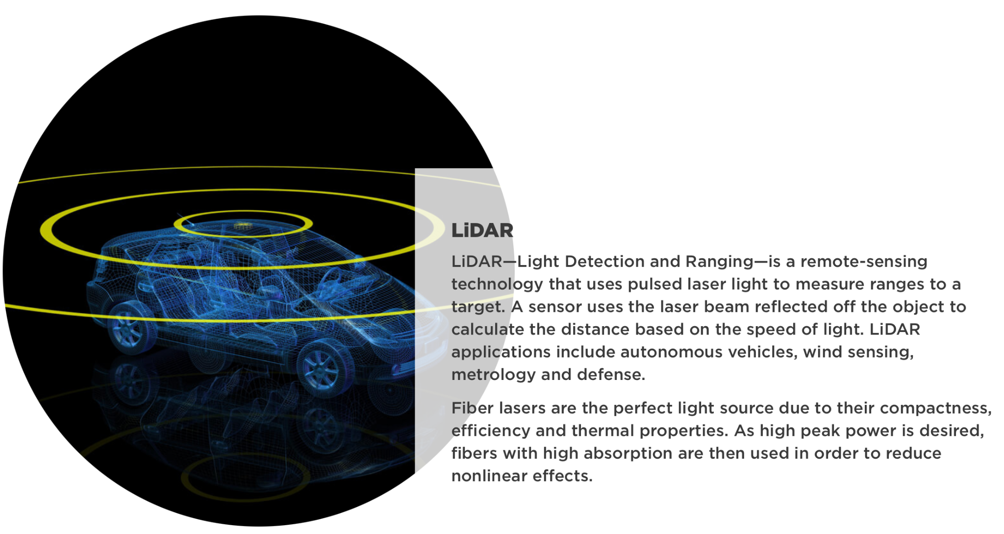
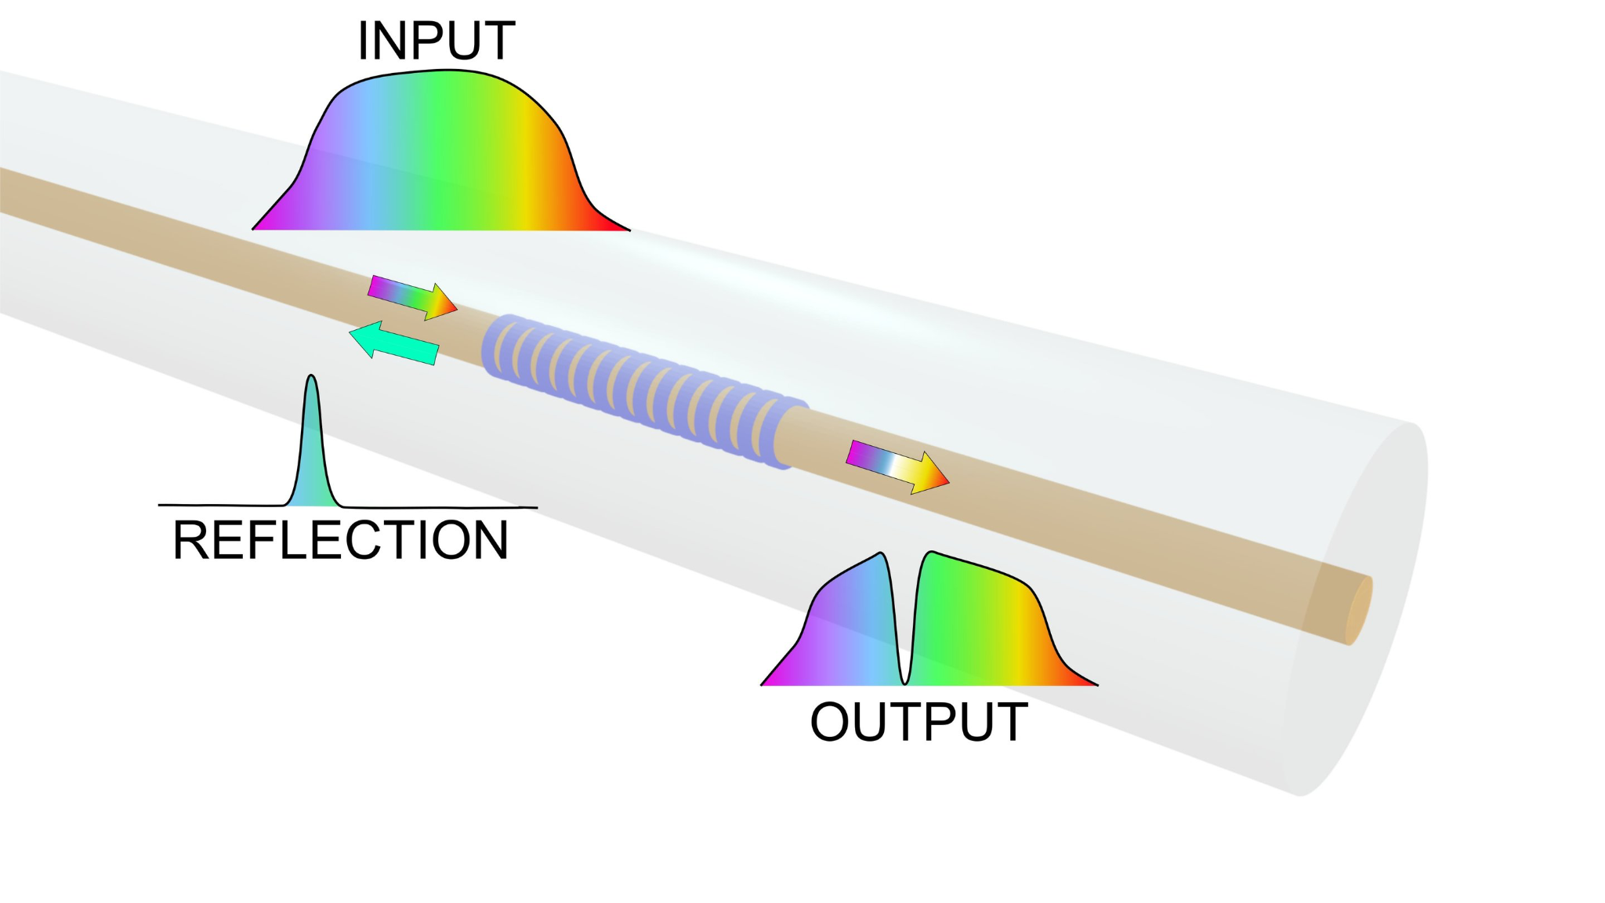
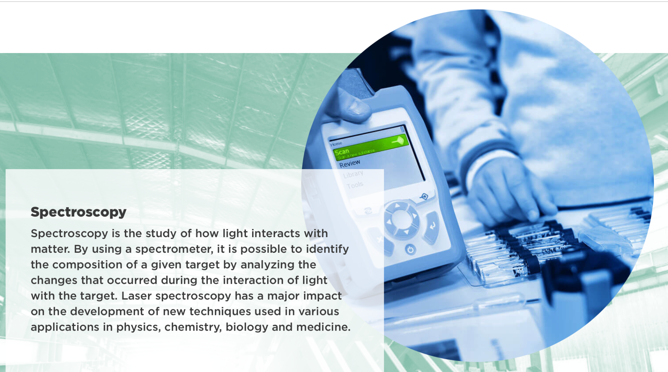
Optical fiber sensors
Fiber Bragg gratings are used to turn an optical fiber into a sensing element by reflecting a specific wavelength back in the direction from which it came. New dissolvable fiber Bragg gratings can be used as sensors in the body and are safe even if the fiber were to accidently break inside the patient. Credit: Maria Konstantaki, Foundation of Research and Technology - Hellas
https://phys.org/news/2018-02-fiber-optic-sensors-dissolve-body.html

Slide 6
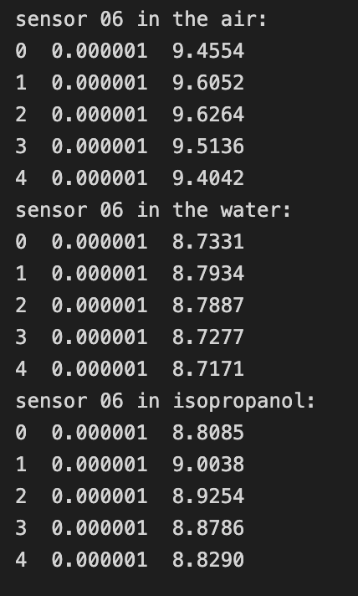
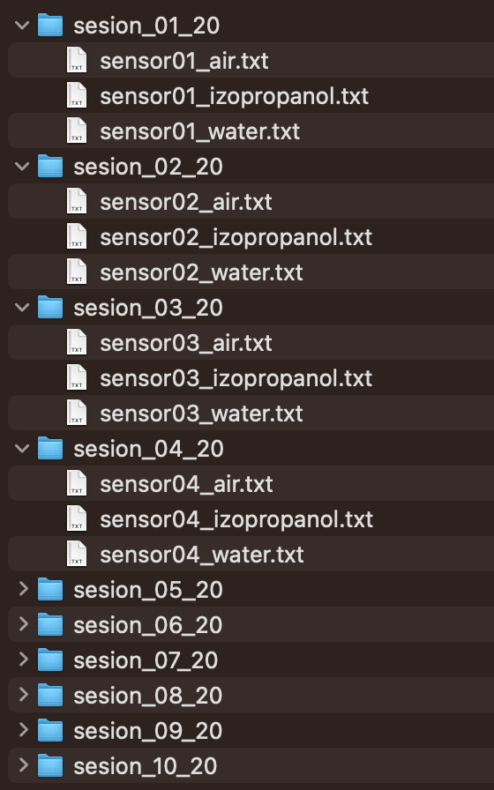
Data characterisation
Collection of measurements based on 10 sensors (each sensor in separated folder). Each sensor was measured three times and results are in three separated files (e.g. sensor01_air.txt, sensor01_water.txt, sensor01_izopropanol.txt).
Dataframes do not contain header
First column is a wavelenght expressed in meters. Usually, wavelenght is expressed in nanometers, which is 1/1000000000 of meter
In the second column we have Signal Amplitude

Slide 7
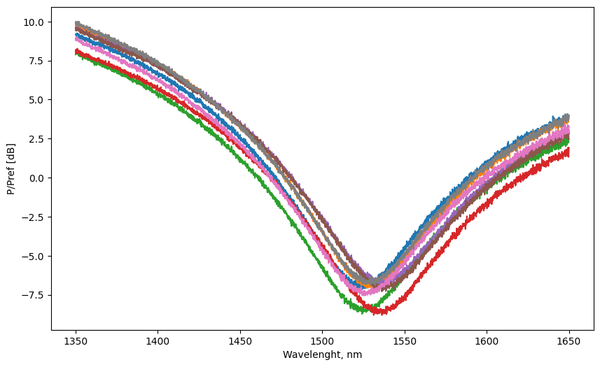
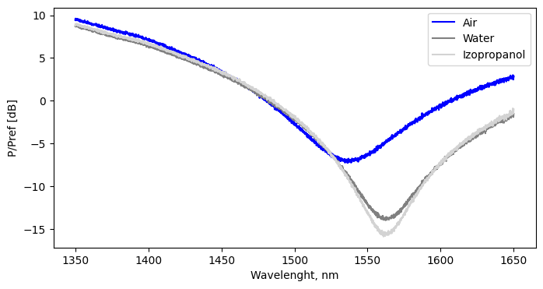
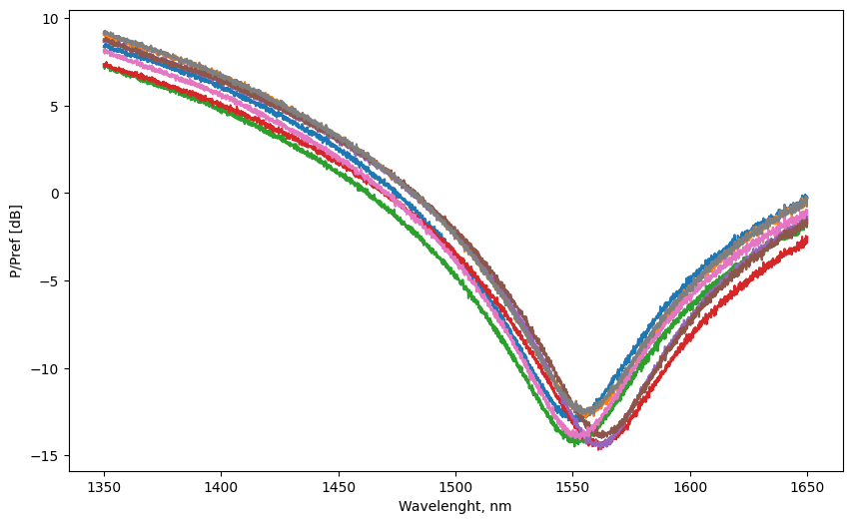
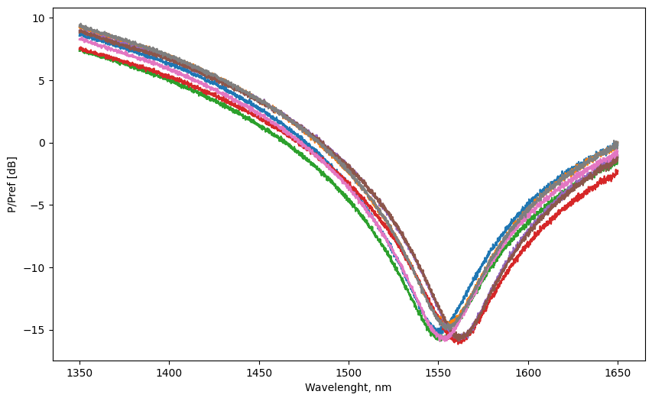
Initial look into data - plotting
Plotted data collected from sensors 1 - 8 (each environment separately)
AIR
Chart of spectrum from Sensor06 readuots in the air, water and izopropanol
WATER
IZOPROPANOL

Slide 8
Goal
Prediction of Amplitude spectrum of produced sensor in water and in izopropanol based on measured amplitude spectrum in the air.
Problems and issues:
I think that data from 10 sensors could be not enough
some ETL implementation may be needed when more and more data will be collected
integration with user-friendly software would be needed
In the future: quality control of the produced sensors based on spectral characteristic via classification of the sensor (like good/not good or some quality classes) -> more specifications and data needed

Slide 9
General plan
Data import and generation of dataframes
Modeling
Deployment
Data are in multiple files structured in folders; .txt files are like .csv files
NOW: Import data from google drive to local drive and import via glob and pd.read_csv() function.
IN THE FUTURE the number of collected data will be higher and some ETL tools should be used.
Data from sensors numbered as 01 - 08 will be used for modeling.
Plotted data are nonlinear distributed.
Models that will be tested:
polynomial regression
regression tree
autoML.
Parameters: R2, MAE, RMSE
The best model will be used to predict data for sensor09 and sensor10, and analyse spectrum

